Slide 1
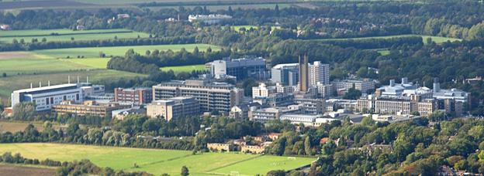
Ureteroscopic Management of Stones: How did the indications change?
Samih Al-Hayek
LRCP (Lond), LRCS (Eng), LMSSA (Lond), MRCS, MD, FRCS (Urol)
Consultant Urological Surgeon & Associate Lecturer
Cambridge University Hospitals, UK
Turkish Urology Academy, Trabzon 7 Sep 2019

Slide 2
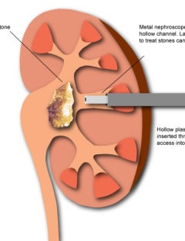
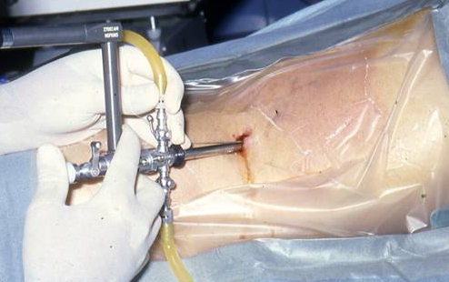
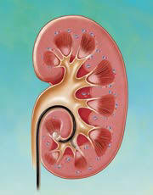
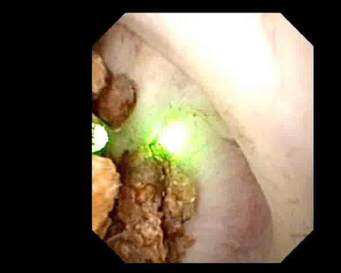
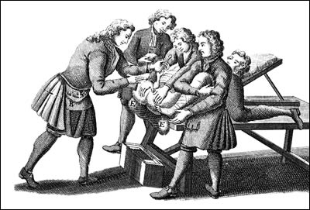
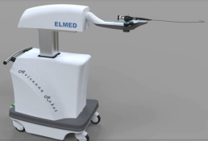
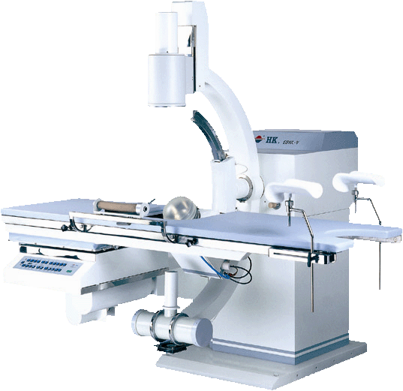
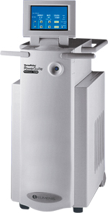
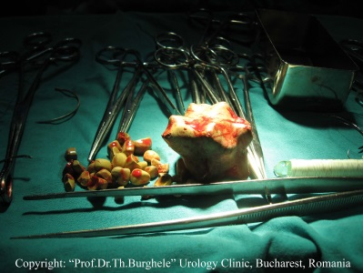
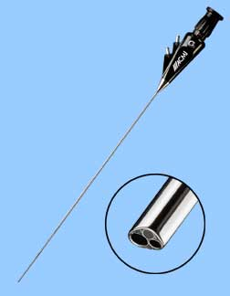
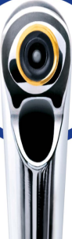

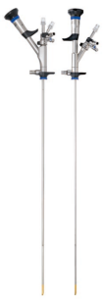
1976 - PCNL (Fernstrom and Johansson)
1998 - fURS (Marshall)
Middle ages
1900
1912
1960
1964
1976
1980
1991
2008
URS Robot
1960 – First medical laser
1991 – First Holmium Laser
1981 – URS rigid
1900 (open surgery)
1980 – ESWL (Chaussi, Dornier HM-3)
We are living now in another urological world!

Slide 3
SURGICAL STONE MANAGEMENT
CHANGING TREATMENT PHILOSOPHIES
  1970’s 1980’s 1990’s 2000’s s
  SWL 0% 95% 85% 60% 40%
  URS / PNL 0% 5% 15% 40% 60%
  Open surgery 100% < 1% < 1% < 1% <1%

Slide 4
URS FOR RENAL CALCULI
Publications in Pubmed
100
50
0
1990
1996
2002
2008

Slide 5
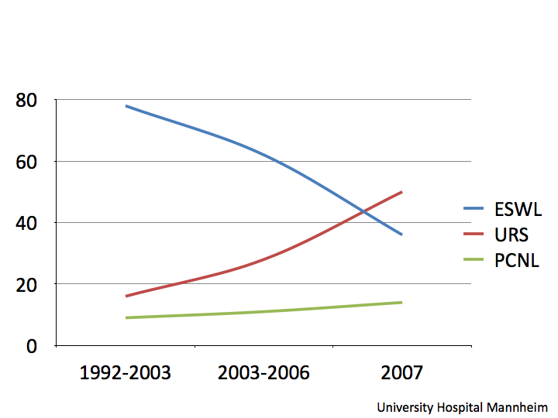
Procedures choice changed

Slide 6
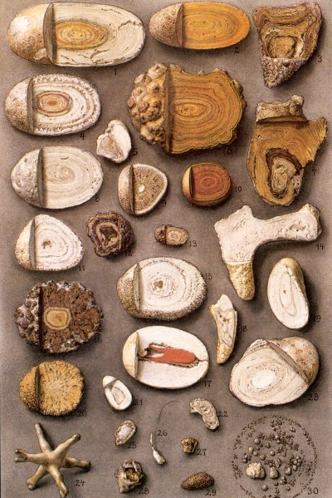
Why are we using ureteroscopy more

Slide 7

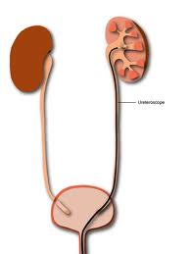
history
First rigid ureteroscope was made in 1960
Perez Castro in 1980 proposed and promoted rigid ureterorenoscopy in the treatment of stones
fURS 1998
Perez Castro E et al ureterorrenoscopia transuretral. Un actual proceder urologico. Arch Esp Urol. 1980; 23:5

Slide 8
Improved design furs
Smaller outer diameter
larger working channel
Impressive deflection (270-275º)
Better fibre optics are now available
Lower costs + increased safety
Low complications
Reduced LOS
High SFE
Retrograde flexible ureterorenoscopic holmium-YAG laser lithotripsy: the new gold standard
Gould DL. et.al. - Tech.Urol.;1998 Mar;4(1):22-4.

Slide 9
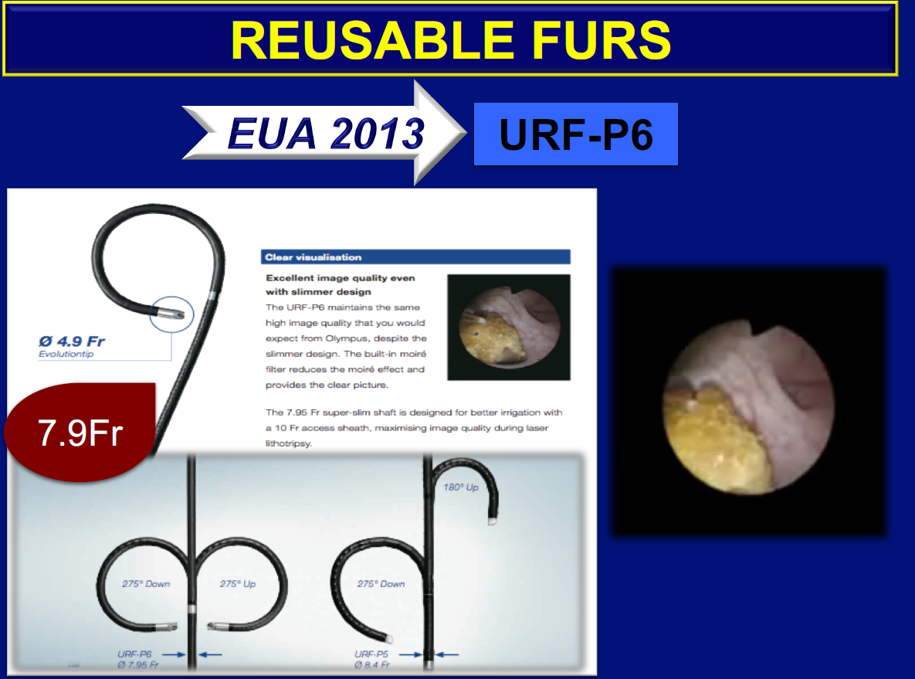

Slide 10
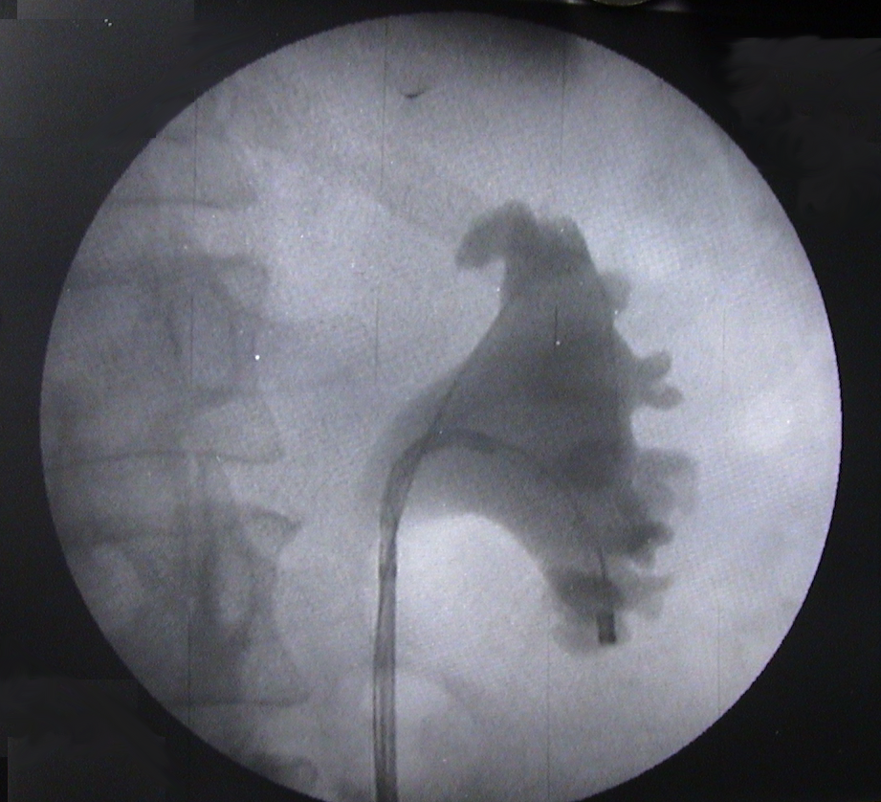
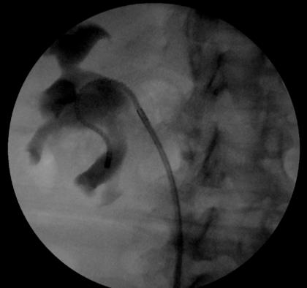
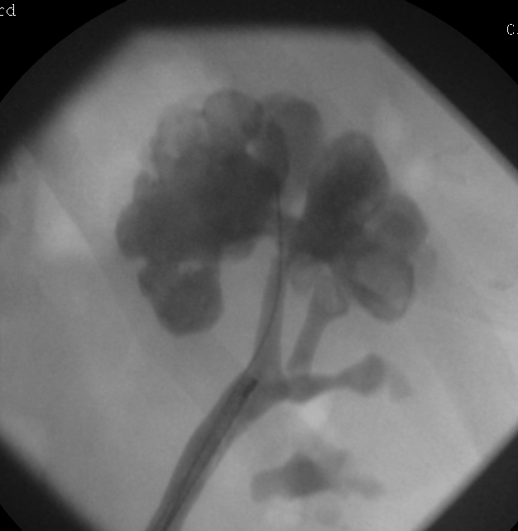
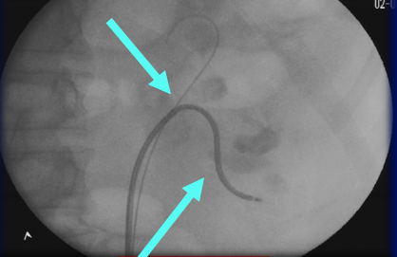
Active and passive deflection

Slide 11
Better vision digital
Digital high definition screens
Digital chips in the scope or in the tip
Better durability with stiffer shaft
Larger endoscopic field
Crystal clear images
NBI capabilities
First digital flexible ureterorenoscope: initial experience.
Mitchell S. et al.; , J.Endourol.; 2008 Jan;22(1):47-50

Slide 12
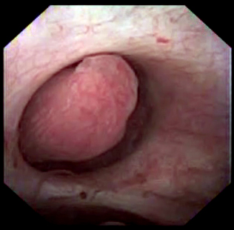
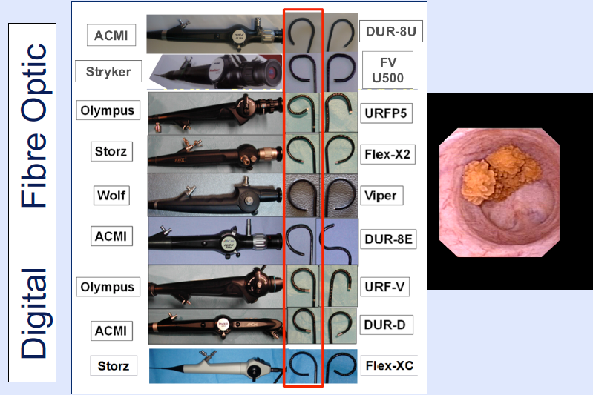
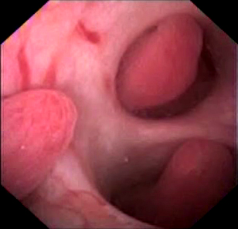
First digital urs experience
Mitchell S. et al.; , J.Endourol.; 2008 Jan;22(1):47-50

Slide 13
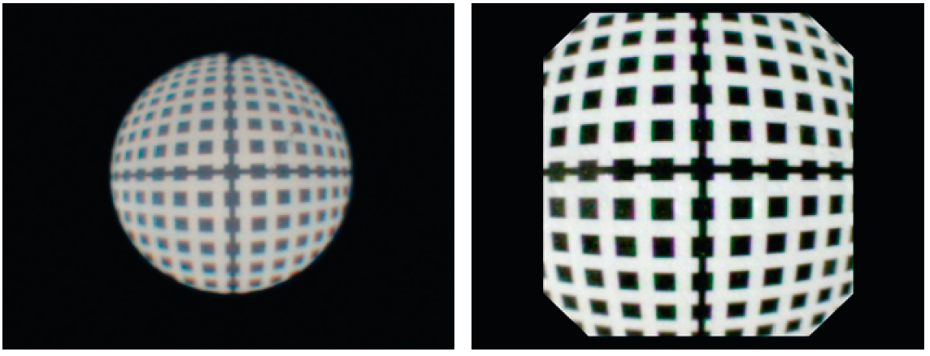
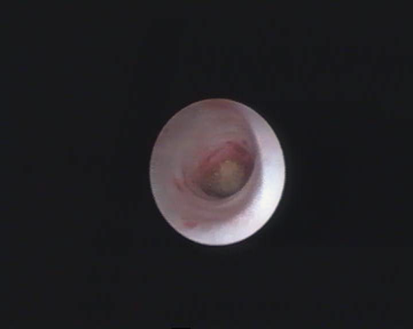
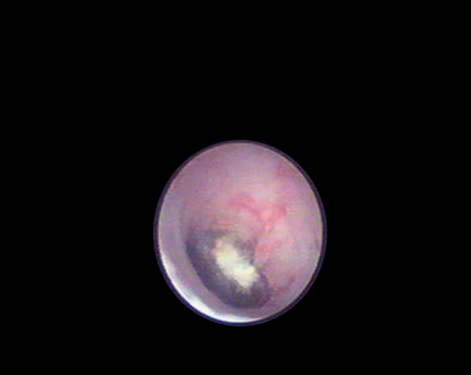
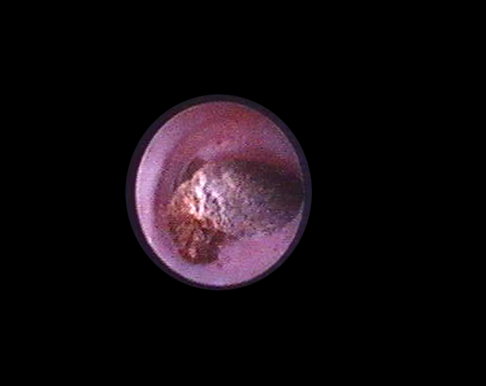
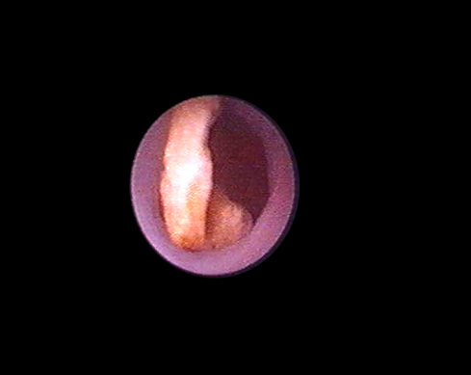
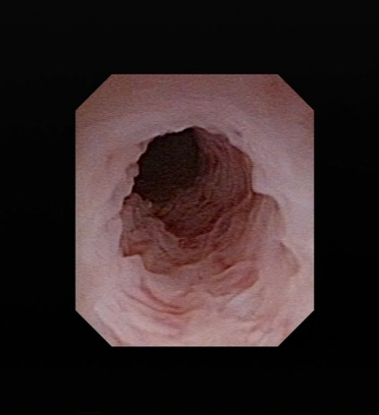
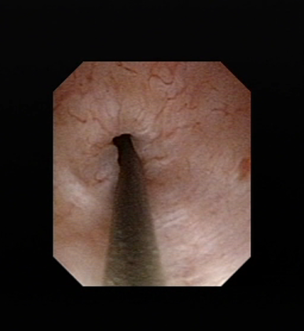
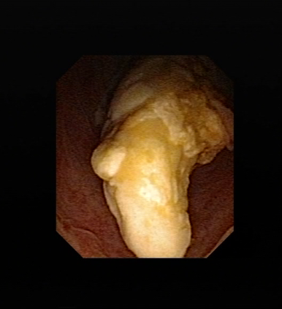
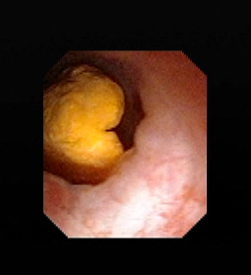
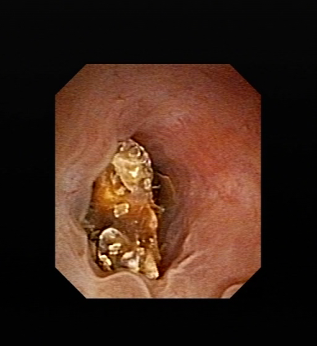
Fiber-optic
Digital
Improved visibility
Notes:
Indeed, nowadays we have the possibility to improve the quality of images for semirigid ureteroscopy. The digital semirigid instruments offered us a wonderful image concomitant with the advantages of durability and rigid maneuverability. Unfortunately, they are still too big (9.5 French)!
13

Slide 14
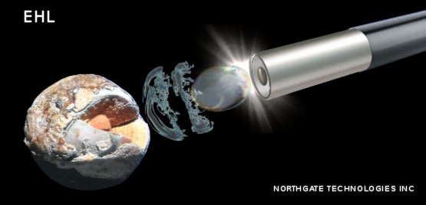
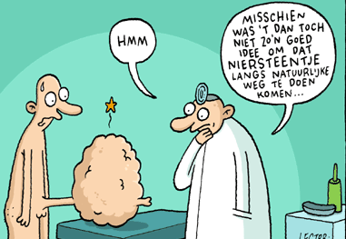

Intra-corporal Lithotripsy
Maybe it was a bad idea to let that stone pass spontaneously

Slide 15
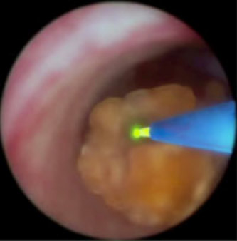
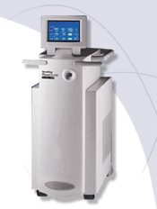
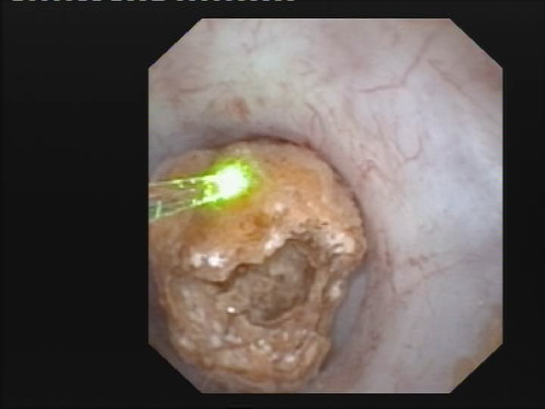
Holmium LASER

Slide 16
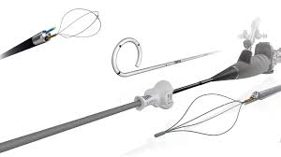
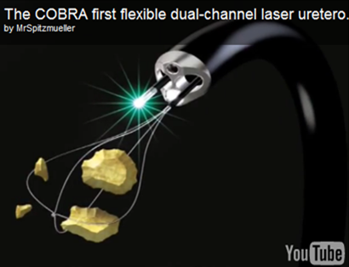
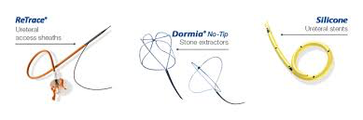
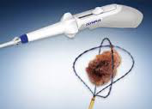
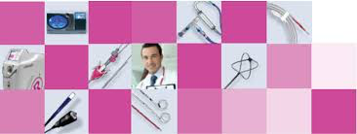
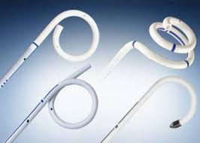
Wide range of adjuncts
Wolf COBRA

Slide 17
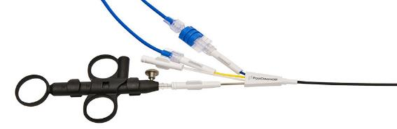
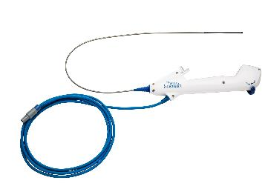
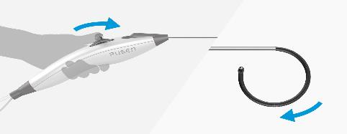
Disposable flexible URS

Slide 18
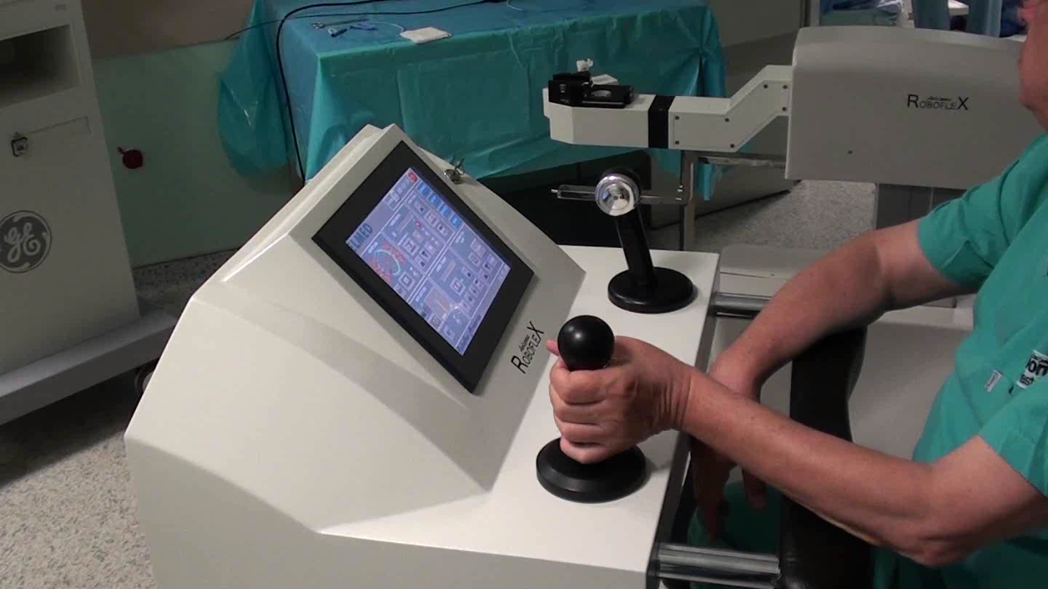
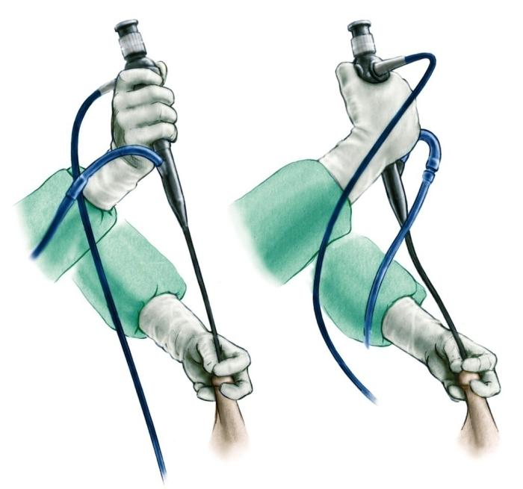
Rotation capability of Roboflex is better than manual.
Manually 120º rotation (We use our fingers to provide more rotation)
Robotically 440º rotation
More accurate tip deflection
By this way we can prevent twisting of the shaft and this may provide longer life time of the endoscope.
Traxer

Slide 19

Safety and efficacy of ureteroscopic lithotripsy in obese patients
Seven studies with 131 patients
(136 renal units)
Obese patients (mean BMI 42.2)
f-URS is a safe and efficient modality for treating obese patients with calculi less than 2 cm in size
Aboumarzouk OM, et al:; BJU Int., 2012.
A systematic review of the literature

Slide 20
f-URS for stones >2cm: A systematic review and meta-analysis
Aboumarzouk OM et.al.; J. Endourol:, 2012
9 studies, 445 patients (460 renal units)
Mean stone size was 2.5 cm
Mean operative time was 82.5 minutes (28-215)
Mean SFR was 93.7% (77%-96.7%), with an average of 1.6 procedures per patient
95.7 % SFR with stones 2-3 cm
84.6 % in those >3 cm (p: 0.01)
In experienced hands, f-URS can successfully treat patients with stones > 2 cm with a high SFR and a low complication rate

Slide 21


3cm stone CT Dec 13

Slide 22



1st stage
Notes:
14/3 most cleard

Slide 24




INDICATIONS IN DIFFICULT ACCESS

Slide 25

ANTEGRADE FLEXIBLE URETEROSCOPY
Very large (>15 mm) impacted stones in the proximal ureter
When the ureter is nor amendable to retrograde manipulation
SFR of 85-100%
P.Geavlete, 2013
Notes:
According to the EAU guidelines on Urolithiasis 2013, percutaneous antegrade removal of the ureteral stone is an alternative when the upper urinary tract is not available for the retrograde approach. We had some cases of very large impacted proximal stones and some patients without the possibility of retrograde manipulation.

Slide 26


EAU Guidelines 2010

Slide 27

Urs IN >1.5CM STONES
EAU Guidelines 2011

Slide 28

EAU guidelines 2012

Slide 29

EAU guidelines 2012

Slide 30

EAU guidelines 2014- 2019

Slide 31

EAU guidelines 2014- 2019

Slide 32





Slide 33









Special indications of fURS and Lasers
MORBIDLY OBESE
COAGULO-PATHY
FOREIGN BODIES
CALICEAL DIVERTICULUM
BODY DEFORMITIES
HORSESHOE KIDNEY
PELVIC KIDNEY
HARD STONES
URINARY DIVERSION
Notes:
So, what about laser lithotripsy? Starting from 1953 with ultrasonic lithotripsy we have especially to remind you the holmium laser introduced in 1995.

Slide 34







3
URS FUTURE PERSPECTIVES: 3D
Notes:
What do we have new and at the same time remarkably promising? We should mention the robotic flexible ureteroscopy for renal calculi. The initial experience from USA and India already defined some comparative studies concerning the standard manual ureteroscopy. The robotic flexible technology is improving and we are waiting for significant clinical applications.

Slide 35
Conclusions
There has been significant improvement in the optics, maneuverability and durability of the ureteroscopes
With advanced large selection of ancillary equipments, LASER, baskets, access sheaths…
This has led to wider indications for the use of ureteroscopy performing endoluminal endourological procedures, diagnostic and therapeutic
Ureteroscopy is safe and effective mini-invasive way of treating stones in all locations of the urinary tract subject to surgeon’s experience
Further advances in technology might increase the range of URS indications and improve its safety
Notes:
Choi 2012, matani 2013, monn 2015

Slide 36





Thank You

